Slide 1
LECTURE # 02
Database Management System SE-208
Database Environment
Course Instructor: Engr. Ruqqiya Asad
‹#›
Notes:
‹#›

Slide 2
Objectives
The Three-Level ANSI-SPARC Architecture
Database Languages
Data Models and Conceptual Modeling
Functions of a DBMS
‹#›
Notes:
‹#›

Slide 3
The Three-Level ANSI-SPARC Architecture
The ANSI SPARC Architecture is a conceptual framework for designing and organizing database management system (DBMS).
It was proposed by the Standard Planning and Requirements Committee(SPARC) of the American National Standard Institute in the late 1070s.
ANSI-SPARC Architecture provides a clear and organized way to understand the complexities of database system.
‹#›
Notes:
‹#›

Slide 4
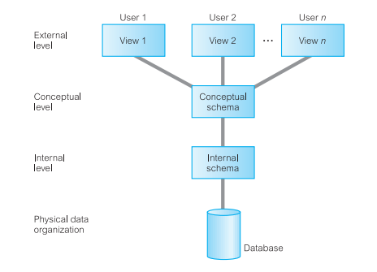
Three-level architecture
External
Conceptual
Internal
‹#›
‹#›
Notes:
‹#›

Slide 5
Objective of the three-level architecture
Each user can access the same data but with a personalized view.
A user can change their view without affecting other users.
Users are independent of physical storage details (like indexing or hashing).
The DBA can modify physical storage structures without affecting user views.
Changes in storage devices do not affect the internal database structure.
The DBA can change the conceptual database structure without impacting all users.
‹#›
‹#›
Notes:
‹#›

Slide 6
External Level
The external level represents the user view of the database.
It defines how individual users of user groups perceive data.
External schema provides a customized view of the data, hiding unnecessary details and complexities.
Changes in the schema do not affect other users or the overall database structure.
File based Systems
‹#›
‹#›
Notes:
‹#›

Slide 7
Conceptual Level
The community view of the database. This level describes what data is stored in the database and the relationships among the data.
Changes to the conceptual schema impact the entire database and all external schemas.
It is a complete view of the data requirements of the organization that is independent of any storage considerations.
The conceptual level represents:
• all entities, their attributes, and their relationships;
• the constraints on the data;
• semantic information about the data;
• security and integrity information.
‹#›

Slide 8
Internal Level
The internal level deals with the physical storage and organization of data.
It covers the data structures and file organizations used to store data on storage devices.
The internal level is concerned with:
storage space allocation for data and indexes,
record descriptions for storage (with stored sizes for data items),
record placement,
data compression and data encryption techniques.
Changes to the internal schema do not affect external views but may impact performance.
‹#›

Slide 9
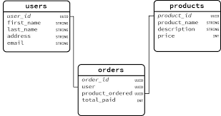
Schemas, Mappings, and Instances
The overall description of the database is called the Database schema.
‹#›

Slide 10
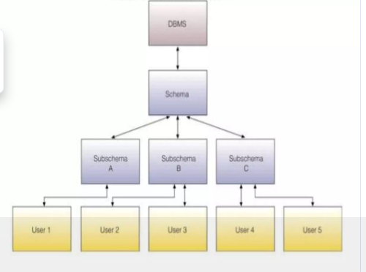
Database sub-schema
Database sub-schema is used to create different and personalized view of the same data.
‹#›

Slide 11
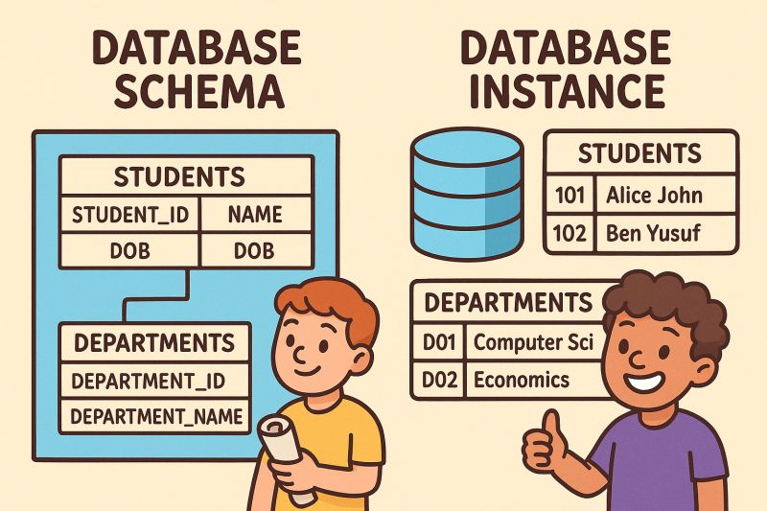
Database instance
The data in the database at any particular point in time is called a database instance.
The schema is sometimes called the intension of the database; an instance is called an extension (or state) of the database.
‹#›

Slide 12
SCHEMAS
At the highest level, we have multiple external schemas (also called subschemas) that correspond to different views of the data.
At the conceptual level, we have the conceptual schema, which describes all the entities, attributes, and relationships together with integrity constraints.
At the lowest level of abstraction we have the internal schema, which is a complete description of the internal model, containing the definitions of stored records, the methods of representation, the data fields, and the indexes and storage structures used.
There is only one conceptual schema and one internal schema per database.
‹#›
Notes:
‹#›

Slide 13
Data Independence
A major objective for the three-level architecture is to provide data independence, which means that upper levels are unaffected by changes to lower levels. There are two kinds of data independence: logical and physical.
Logical data independence: The immunity of the external schemas to changes in the conceptual schema.
Physical data Independence: The immunity of the conceptual schema to changes in the internal schema.
‹#›

Slide 14
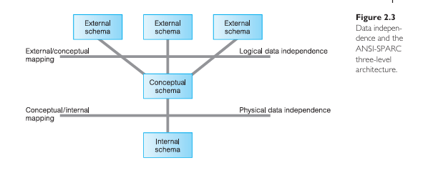
Data independence and the ANSI-SPARC three-level architecture.
‹#›

Slide 15
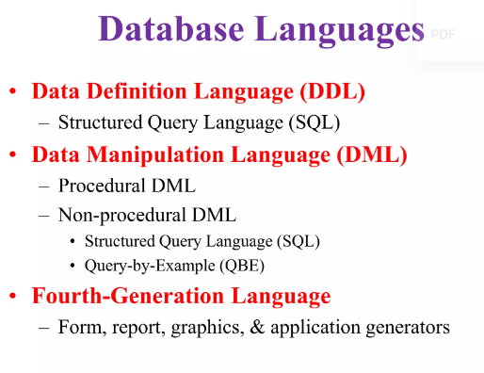

Slide 16
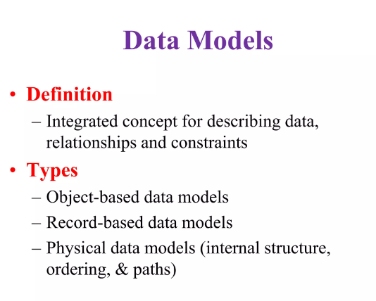

Slide 17
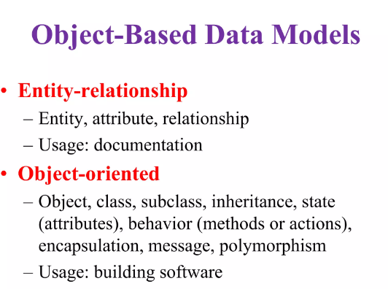

Slide 18
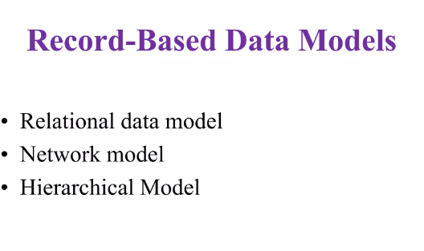

Slide 19
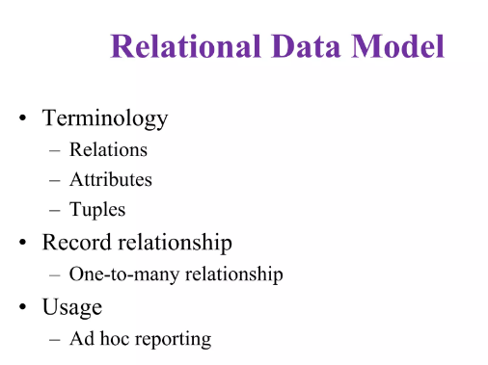

Slide 20
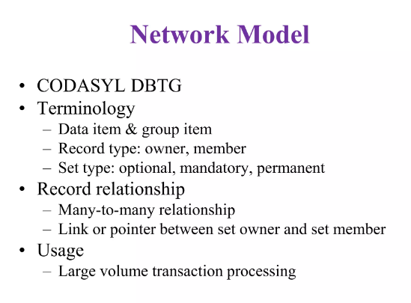

Slide 21
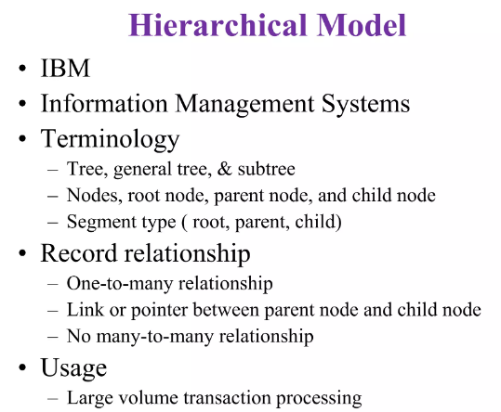

Slide 22
Physical Data Model
Physical data models describe how data is stored in the computer, representing information such as record structures, record orderings, and access paths.
There are not as many physical data models as logical data models; the most common ones are the unifying model and the frame memory.

Slide 23
Conceptual Modeling
The conceptual schema is the core (heart) of the database
It supports all external views (user views)
Process of designing a high-level model of organizational data
Independent of:
DBMS
Programming languages
Application programs
Physical storage details
Focuses on:
What data is needed
Relationships between data
Business rules

Slide 24
Functions of a DBMS
Data storage, retrieval, and update
A user-accessible catalog
Transaction support
Concurrency control services
Recovery services
Authorization services
Support for data communication
Integrity services
Services to promote data independence
Utility services

